Slide 1
Implementation of Discrete Time Systems

Slide 2
Design and Implementation
Filter Design
  Given some frequency response specification, determine the type, order and coefficients of a digital filter to best meet the specification.
Filter Implementation
  Given some filter design, including the type, order and coefficients of the filter, determine a way of implementing the filtering operation using appropriate hardware or software.

Slide 3
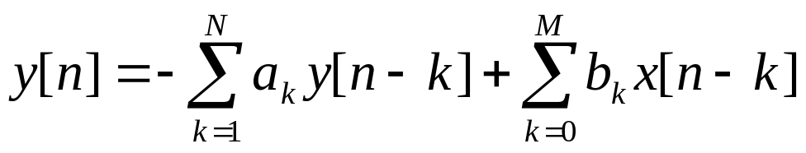
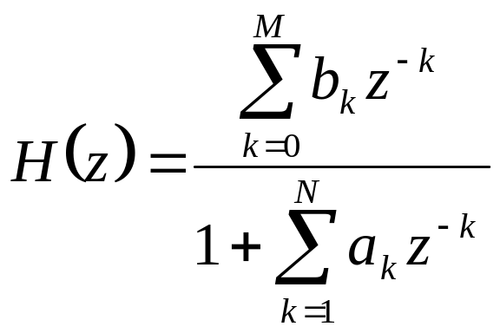
Considerations about structures for the realization of discrete time systems
Discrete linear time invariant systems are described in time and z domain by:
Difference equation
System function
(1)
(2)

Slide 4
Considerations about structures for the realization of discrete time systems
Such filters can be implemented in many different ways
  equivalent in function for infinite precision computation
  not equivalent for fixed point computation
    • some may be more robust to rounding effects

Slide 5
Considerations about structures for the realization of discrete time systems
Why not just implement (1) and (2) directly, without any rearrangement?
What are the benefits gained in the corresponding implementation?
The major factors that influence the choice of specific realization are:
  Computational complexity
  Memory requirements
  Finite-word-length effects

Slide 6
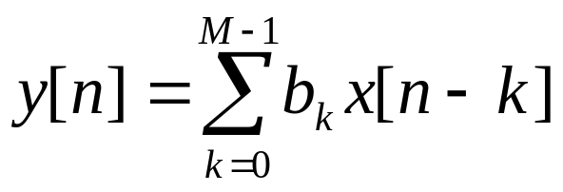
Structures for FIR Systems
Difference equation
Output is weighted sum of current and previous M inputs
The filter has order M
The filter has M+1 taps, i.e. impulse response is of length M+1

Slide 7
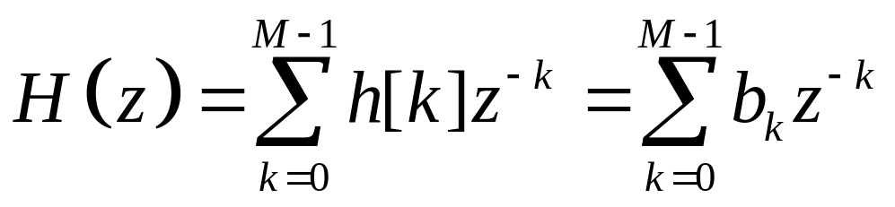
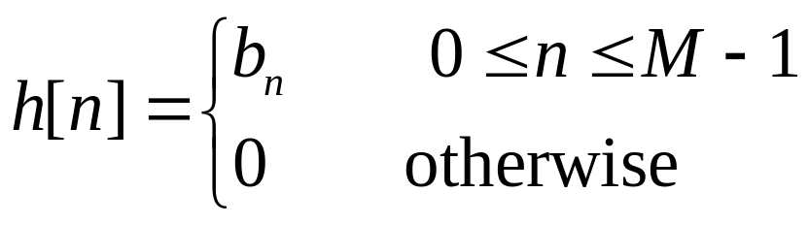
Structures for FIR Systems
System function
H(z) is a polynomial in z⁻¹ of order M
H(z) has M poles at z = 0 and M zeros at positions in the z-plane determined by the coefficients b_{k}

Slide 8
Structures for FIR Systems
Structures
Direct – form structures
Cascade – form structures
Frequency – sampling structures
Lattice structures

Slide 9
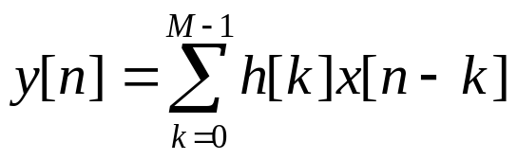

Direct – form structure
Direct form realization of FIR system

Slide 10
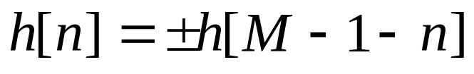
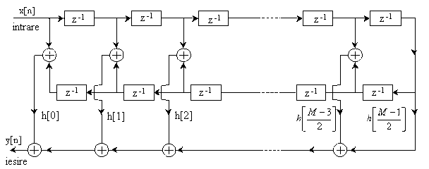
The unit sample response of linear-phase FIR system satisfies the symmetry or asymmetry condition
Direct form realization of linear – phase FIR system (M odd)

Slide 11
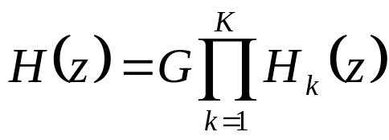
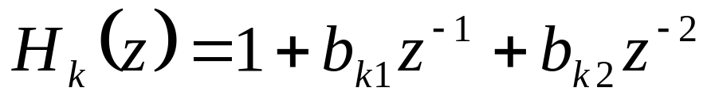
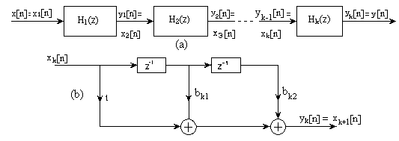
Cascade form structures
a) Cascade realization of an FIR system, b) basic second order section of a FIR system

Slide 12
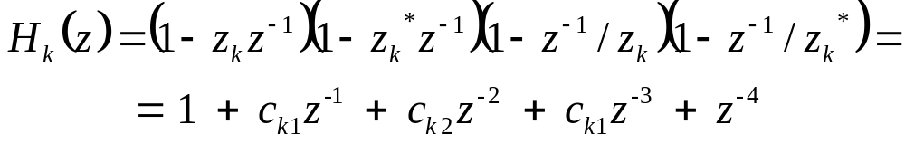
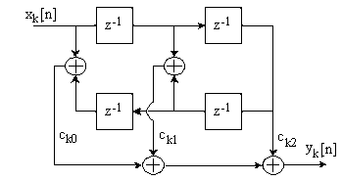
The zeros of H(z) of a linear-phase FIR system exhibit a form of symmetry
Fourth-order section in a cascade realization of a linear-phase FIR System

Slide 13
Structures for IIR systems
Structures
Direct – form structures
Cascade – form structures
Parallel – form structures
Lattice structures
Lattice – ladder structures

Slide 14
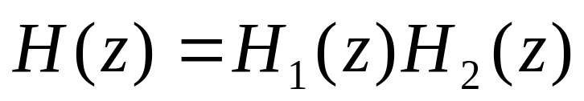
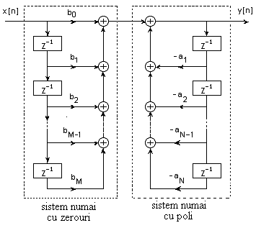
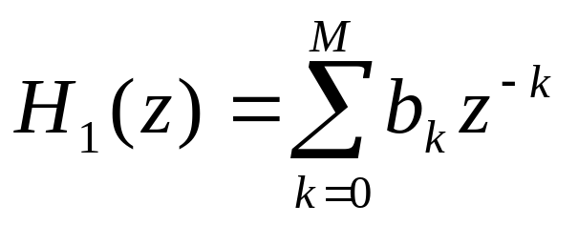
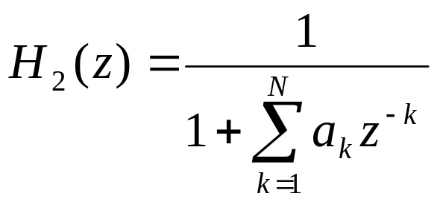
Direct – form realization of IIR Systems
System function
Direct – form I realization
M+N+1 multiplications, M+N additions, M+N memory locations.

Slide 15

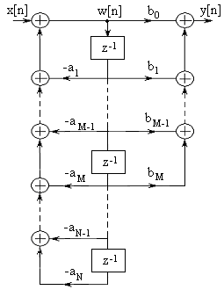

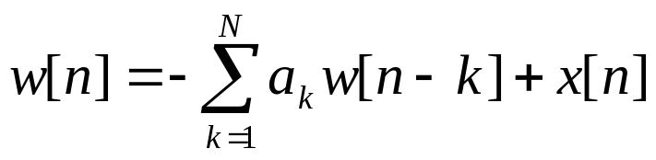
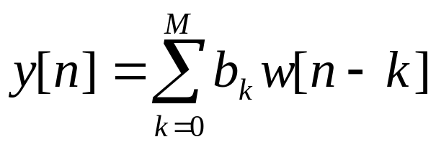


Direct – form II realization
M+N+1multiplications, M+N additions, max{M,N} memory locations

Slide 16
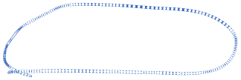

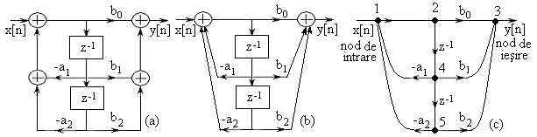
Signal flow graphs and transposed structures
The basic elements of a flow graph:
nodes (summing, branching)
branches (transmittances).
Second order filter structure and the corresponding signal flow graph

Slide 17
The transposition or flow-graph reversal theorem
If we reverse the directions of all branch transmittances, interchange the input and output in the flow graph and change the adders into nodes and nodes into adders, the system function remains unchanged.
The resulting stuctures is called a transposed structure or a transposed form.

Slide 18
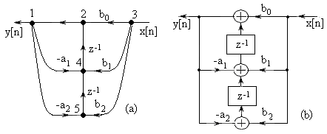
(a) Signal flow graph of transposed structure (b) its realization

Slide 19
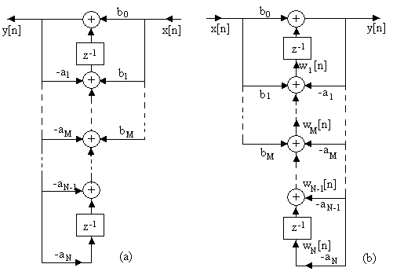
Transposed direct form II structure

Slide 20
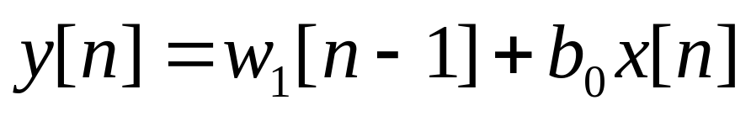
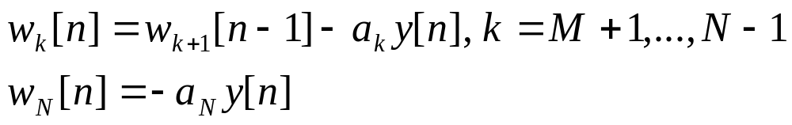
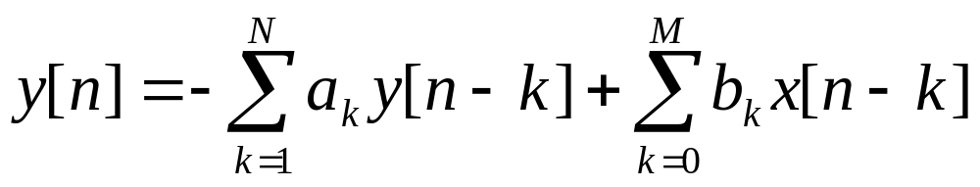
The transposed direct form II realization can be described by the set of difference equations for N>M:
The transposed direct form II realization requires the same numbers of multiplications and memory locations. The number of additions exceeds with 1 the number of memory locations.

Slide 21

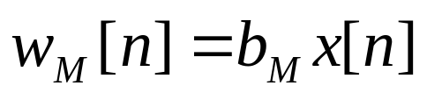
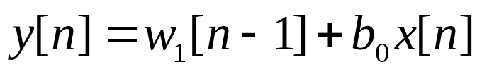
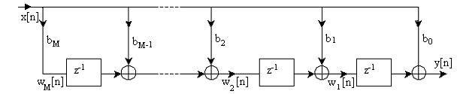
The implementation of the transposed form of a FIR system of can be obtained by setting
The corresponding difference equations describing the transposed FIR system is
Transposed FIR structure

Slide 22
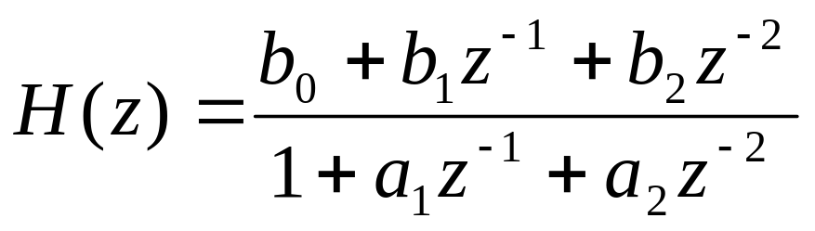
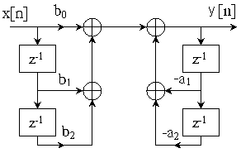
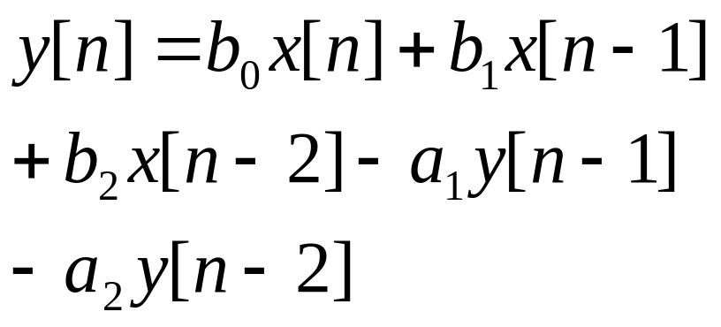
Some second order modules for discrete time systems
Direct form I

Slide 23
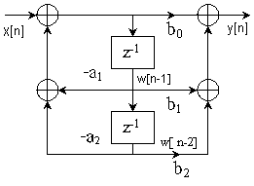
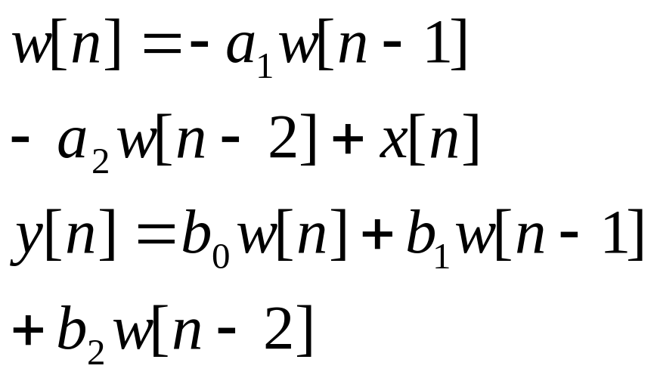
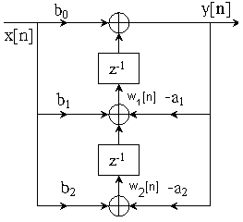
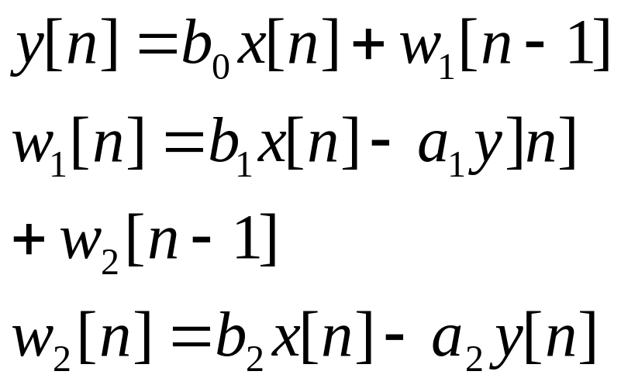
Regular direct form II
Transposed direct form II

Slide 24
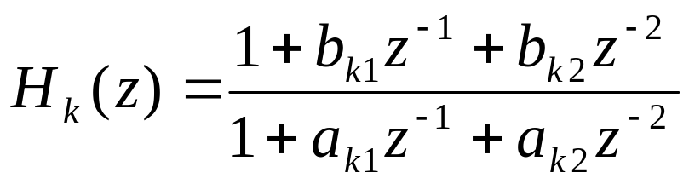
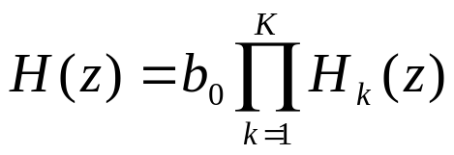
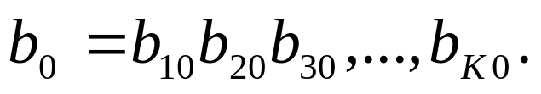
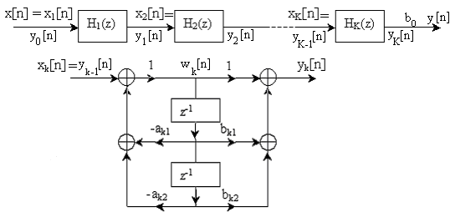
Cascade – form structures of IIR systems
The system can be factored into a cascade of second order subsystems
Cascade structure of second order systems and a realization of of each second order section

Slide 25
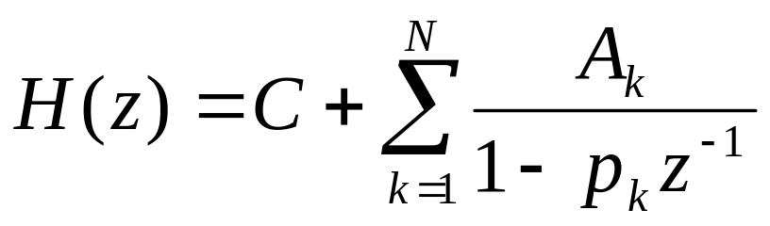

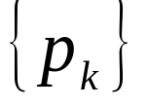
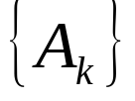
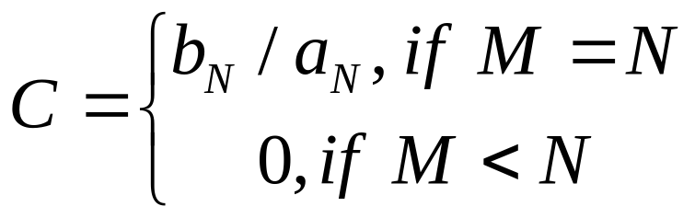
Parallel – form structures of IIR systems
Parallel form realization of IIR systems – by partial - fraction expansion of H(z)
For and distinct poles
- poles
- coefficients (residues) in the partial - fraction expansion

Slide 26
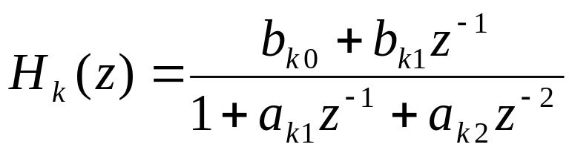
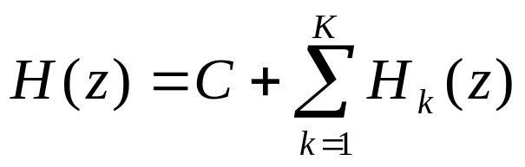
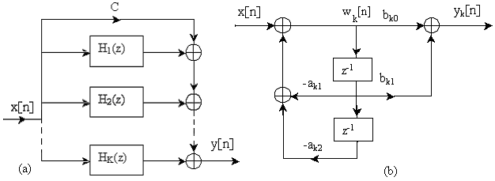
We can combine pairs of complex – conjugate poles to form two-pole subsystems with system function
Parallel structure of IIR system,
Structure of second order section in a parallel IIR system realization

Slide 27
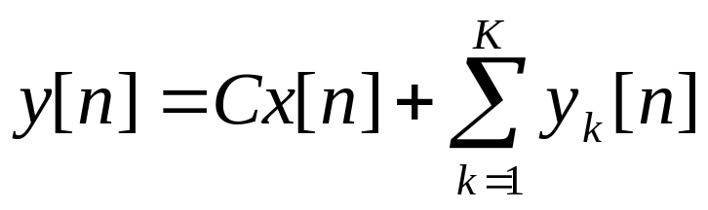
The parallel – form realization is described by the following set of difference equations :

Slide 28
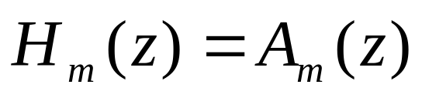






Lattice structure for FIR filters
Lattice filters are used extensively in speech processing and implementation of adaptive filters.
Consider a sequence of FIR filters with system functions
m = 0, 1, 2, ..., M - 1
where
and
The unit sample response of the m-th filter is and , k = 1, 2, …., m
(3)
(4)

Slide 29





Lattice structure for FIR filters
We define .
is the input sequence to the filter
is the output sequence
We give two direct – form structures of the FIR filters. (Fig. 1)
(5)

Slide 30





Lattice structure for FIR filters
Fig 1. Direct – form realization of (a) a FIR filter and
(b) A FIR predictor filter

Slide 31



Lattice structure for FIR filters
The stuctures in Fig. 1 are intimately related with the topic of linear prediction, where
is the one-step forward predicted value of x[n] based on m past inputs, x[n-1], x[n-2], …, x[n-m], and , from(5), is called a prediction error filter.
The output of the FIR filter given in (5) can be seen as the error between the actual value of x[n] and its predicted value
(6)

Slide 32


Lattice structure for FIR filters
Consider a filter of order m = 1. The output of such a filter is
K₁=α₁[1] reflection coefficient.
(7)
Figure 2. Single-stage lattice filter

Slide 33

Lattice structure for FIR filters
For this structure, we can write:
Consider a FIR filter for which m = 2.
The output from the direct-form structure is
(8)
(9)

Slide 34


Lattice structure for FIR filters
The output from the second stage is
Figure 3. Two-stage lattice filter
(10)

Slide 35



Lattice structure for FIR filters
Substituting for f₁[n] and g₁[n] from (8) into (10), we have
(11) is identical to the output of the direct-form FIR filter as given by (9) if
or, equivalently
(11)
(12)
(13)

Slide 36



Lattice structure for FIR filters
We can demonstrate by induction the equivalence between an m-th order direct-form FIR filter and an m-order or m-stage lattice filter.
The lattice filter is generally described by the following set of order-recursive equations:
The output of the (M-1)-stage lattice filter corresponds to the output of an (M-1)-order filter
(14)
(15)
(16)

Slide 37



Lattice structure for FIR filters
Figure 4. a) (M-1)-stage lattice filter, b) A typical stage

Slide 38





Lattice structure for FIR filters
The output f_{m}[n] of an m-stage lattice filter can be expressed as
or, equivalently,
can be expressed in the form of a convolutional sum by using another set of coefficients β_{m}[n]
(17)
(18)
(19)

Slide 39




Lattice structure for FIR filters
The coefficients for the lattice filter that produces are
The coefficients for the lattice filter that produces
are
Note: The coefficients are in reverse order

Slide 40


Lattice structure for FIR filters
For the two-stage lattice filter, can be expressed as

Slide 41





Lattice structure for FIR filters
For the filter that produces the output , the coefficient are
For the filter that produces the output , the coefficients are
Note: The coefficients are also in reverse order

Slide 42






Lattice structure for FIR filters
The output from an m-stage lattice filter can be expressed by the convolutional sum
The coefficients are associated with a filter that produces but operate in reverse order.
Consequently
with
(20)

Slide 43




Lattice structure for FIR filters
Values x[n], x[n-1], . . . ,x[n-m+1], are used to linearly predict the signal value x[n-m]. The predicted value is
k = 0, 1, . . . ,m
The prediction performed in (21) is called backward prediction.
where
(21)
(22)
(23)

Slide 44








Lattice structure for FIR filters
The zeros of the FIR filter with system function are the reciprocals of the zeros of .
is called the reciprocal or the reverse polynomial of
(24)
(25)
(26)

Slide 45











Lattice structure for FIR filters
m = 1, 2, . . . , M-1
m = 1, 2, . . . , M-1
m = 1, 2, . . . , M-1
m = 1, 2, . . . , M-1
(27)
(28)
(29)
(30)
(31)
(32)
(33)

Slide 46




Conversion of lattice coefficients to direct-form filter coefficients
m = 1, 2, . . . , M-1
m = 1, 2, . . . , M-1
The solution is obtained recursively beginning with m = 1
The coefficients are determined recursively from
(34)
(35)
(36)
(37)

Slide 47



Conversion of lattice coefficients to direct-form filter coefficients
(38)
(39)
(40)

Slide 48






Conversion of direct-form FIR filter coefficients to lattice coefficients
Suppose that we are given the FIR coefficients for the direct-form realization or, equivalently, the polynomial and we wish to determine the corresponding lattice filter parameters
For the m-stage lattice we have
For determining we need polynomials
We need to compute polynomials starting from m = M-1 and stepping down successively to m = 1

Slide 49







Conversion of direct-form FIR filter coefficients to lattice coefficients
The procedure works as long as for m = 1,2 ...,M-1
For m = M-1, M-2,...,1 we have
(41)
(42)
(43)

Slide 50



Lattice structures for all-pole IIR systems
Let us begin with an all-pole system described by
The corresponding difference equation for this IIR system is
(44)
(45)
Figure 5. Direct-form realization of an all-pole system

Slide 51



Lattice structures for all-pole IIR systems
In (45) we interchange the roles of input and output
Or, echivalently written,
Eq. (47) describes an FIR system with the system function
One system can be obtained from the other simply by interchanging the roles of input and output.
(46)
(47)

Slide 52





Lattice structures for all-pole IIR systems
For the all-zero (FIR) lattice filter we redefine the input as
and the output as
With these definitions the quantities must be computed in descending order
Eq. (16) for remains unchanged.
(48)
(49)

Slide 53




Lattice structures for all-pole IIR systems
Which correspond to the structure shown in Fig. 6
(50)
(51)
(52)
(53)
Figure 6. Lattice structure for an all-pole IIR system

Slide 54



Lattice structures for all-pole IIR systems
Consider the case when N = 1. The equations reduce to
(54b) represents an all-pole IIR system,
(55) represents afirst-order FIR system
(54a)
(54b)
(55)

Slide 55

Lattice structures for all-pole IIR systems
Case N=2
Figure 7. a) Single pole and b) two-pole lattice system

Slide 56


Lattice structures for all-pole IIR systems
The corresponding equations are
(56)
(57)
(58)
(59)

Slide 57




Lattice structures for all-pole IIR systems
(60)
The all-pole lattice structure has an all-zero path with input
and output , identical to its counterpart all-zero path in the all-zero lattice structure.
- the system function of the all-zero path common to both lattice structures (called backward system function)

Slide 58


Lattice structures for all-pole IIR systems
The all-zero and all-pole lattice structures are characterized by the same set of lattice parameters K₁, K₂, …,K_{N} .
The two lattice structures differ only in the interconnections of the signal flow graph.
The algorithms for converting between the system parameters
in the direct-form realization of an FIR system and the parameters of its lattice counterpart apply as well to the all-pole structure.

Slide 59

Lattice-ladder structures for all-pole IIR systems
The all-pole lattice provides the basic building block for lattice-type structures that implement IIR systems that contains both poles and zeros.
Consider the IIR system described by the system function
(61)

Slide 60


Lattice-ladder structures for all-pole IIR systems
In the direct form II structure, the system is described by the difference equations
which describes the input – output of an all-pole IIR system
and
which describes the input – output of an all-zero system
(62)
(63)

Slide 61

Lattice-ladder structures for pole-zero IIR systems
The output of the all-zero system is simply a linear combination of delayed outputs from all-pole system
Figure 8. Direct form II realization of IIR system for N=M

Slide 62





Lattice-ladder structures for pole-zero IIR systems
Zeros result from forming a linear combination of previous outputs.
The system is an all-zero system.
Any linear combination of is also an all-zero system.
An all-pole lattice structure with parameters
to which we add a ladder part performing a linear combination of weighted by result in a pole-zero IIR system which has the lattice-ladder structure shown below.

Slide 63


Lattice-ladder structures for pole-zero IIR systems
The output is
are the parameters that determine the zeros of the system.
The system function corresponding to the pole-zero system is
(64)
(65)

Slide 64




Lattice-ladder structures for pole-zero IIR systems
and
(66)
(67)

Slide 65





Lattice-ladder structures for pole-zero IIR systems
Figure 9. Lattice-ladder structure for the realization of a pole-zero system

Slide 66










Lattice-ladder structures for pole-zero IIR systems
First, we determine the parameters of all – pole lattice structure
The ladder coefficients are
for all m
The lattice ladder structures require minimum memory locations, but not the minimum of multiplications. They are the most used in practical applications.
(68)
(69)
(70)
(71)

Slide 67
State-space system analysis and structures
So far - LTIS – input – output (external) description.
Basic concepts in the space-state (internal) description of LTIS.
State-space description involves:
  A relationship between the input and output signals
  An additional set of variables – state variables.

Slide 68





State-space system analysis and structures
In state-space description, the mathematical equations describing the system are usually divided into two parts:
  A set of mathematical equations relating the state variables to the input signal
  A second set of mathematical equations relating the state variables and the current input to the output signal.
Definition. The state of a system at time is the amount of information that must be provided at time , which, together with the input signal for uniquely determine the output of the system for all .

Slide 69


State-space descriptions of systems characterized by difference equations
Internal description splits the system into two component parts:
  A dynamic subsystem (memory), which updates the state variables at time n+1 according to the state variables at time n and the input at time n;
  A static subsystem (memoryless) which provides the output at time n according to state variables and the input at the same time.
The space state description of a causal system with N state variables consists in two sets of equations
  State equation i=1,2,…,N
  Output equation
(72)
(73)

Slide 70


State-space descriptions of systems characterized by difference equations
Consider a discrete, linear, time invariant system
The direct-form realization is shown in Fig. 10. The state variables are the output of memory locations.
(74)
(75)

Slide 71






State-space descriptions of systems characterized by difference equations
Figure 10. Direct form II realization (a)
State-space realization of system (74)

Slide 72






State-space descriptions of systems characterized by difference equations
(76)
(77)
(78)
(79)

Slide 73











State-space descriptions of systems characterized by difference equations
Figura 11. Implem. in (a) direct form 2 transposed, and
(b) State space type 2, equation (74)

Slide 74



State-space descriptions of systems characterized by difference equations
In matrix form, (80) and (77) are written as (Type 1 state-space realization)
(80)
(81)
(82)

Slide 75



State-space descriptions of systems characterized by difference equations
Type 2 state-space realization
Generalization
(83)
(84)
(85)

Slide 76









State-space descriptions of systems characterized by difference equations
v[n] =
F= q = g =
v[n+1] = Fv[n] + qx[n]
y[n] = gtv[n] + dx[n]
(86)
(87)
(88)
(89)

Slide 77




State-space descriptions of systems characterized by difference equations
For type 1 implementation
F= q = g= d=
(90)

Slide 78



State-space descriptions of systems characterized by difference equations
For type 2 implementation
F= q = g= d=
(91)

Slide 79













Relationships between input-output and state-space description
The input-output relationship does not unequely describe the internal structure of the system.
Consider an N-dimensional system with the state-space representation
Let P be any NxN matrix whose inverse matrix P⁻¹, exists. We define
(92)
(93)
(94)
(95)
(96)
(97)

Slide 80



Relationships between input-output and state-space description
The state equations can be expressed
(98)
(99)
(100)

Slide 81
Relationships between input-output and state-space description
By a simple linear transformation of the state variables, we have generated a new set of state equations and an output equation, in which the input x[n] and the output y[n] are unchanged.
There is an infinite number of choices of the transformation matrix P
There is an infinite number of state-space equations and structures for a system.
A state-space realization of a system is said to be minimal if the dimension of the state space (the number of state variables) is the smallest of all possible realizations.

